Slide 1
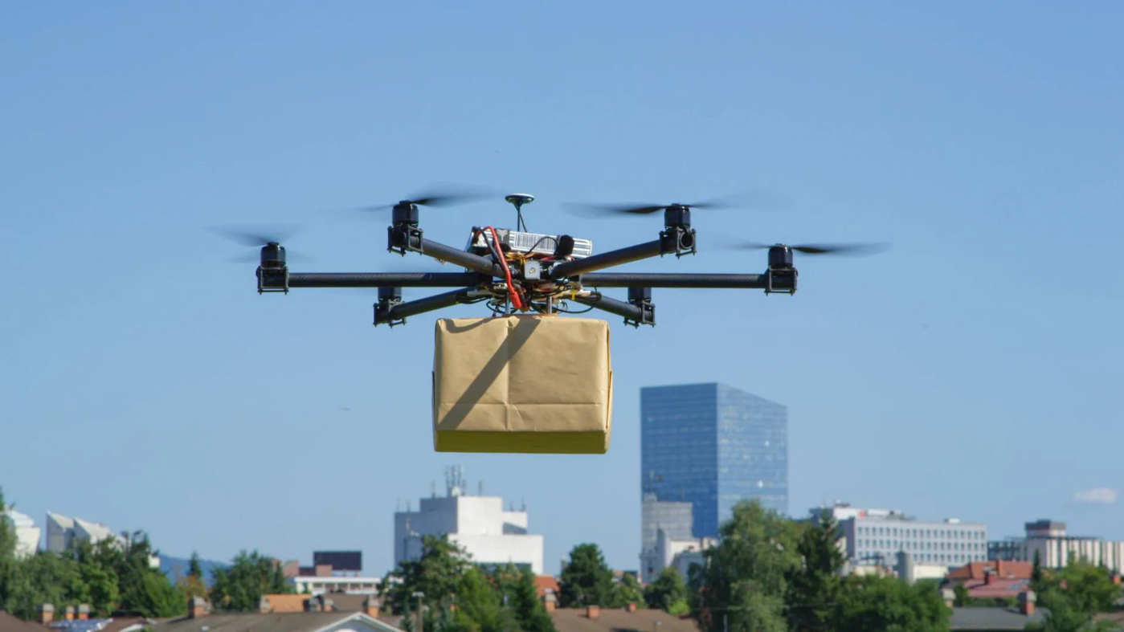
Adaptive and Autonomous Aerospace Systems «”Predictor-based adaptive control for delivery UAV”»
Academic Year 2025/2026
Professor: Davide Invernizzi Authors: Andrés T. J., Di Mauro M., Galluzzi G.

Slide 2
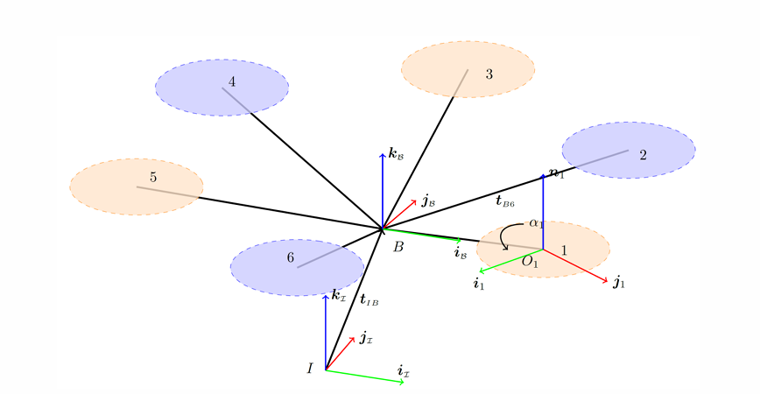
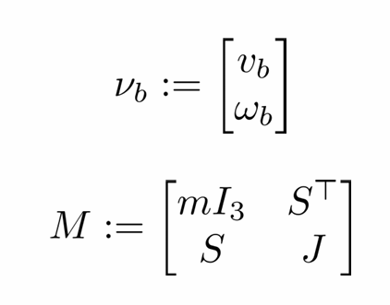
UAV MODEL
The UAV dynamic model:
With:

Slide 3
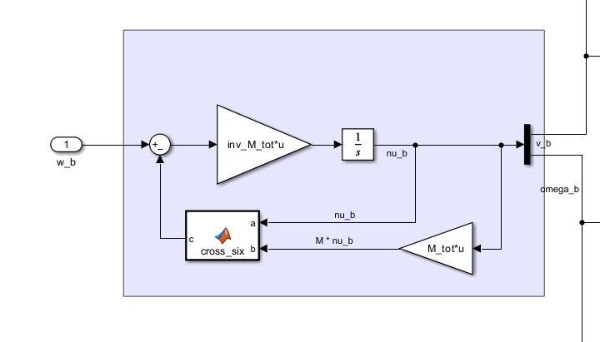
UAV MODEL

Slide 4
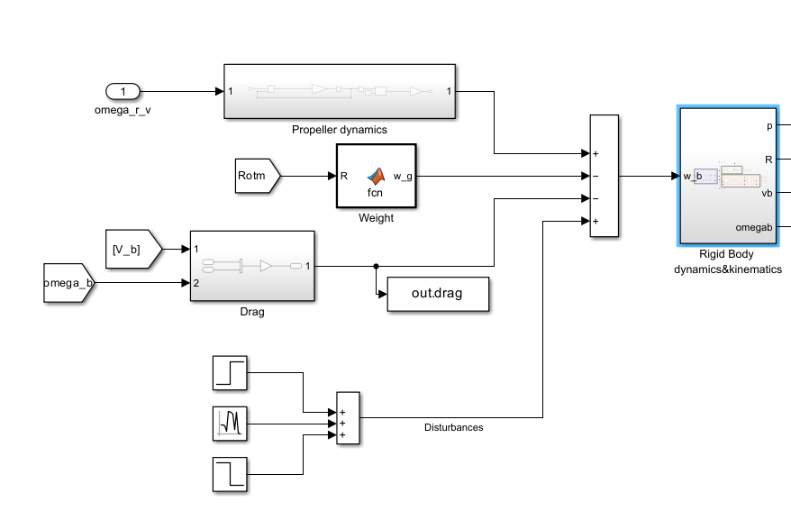
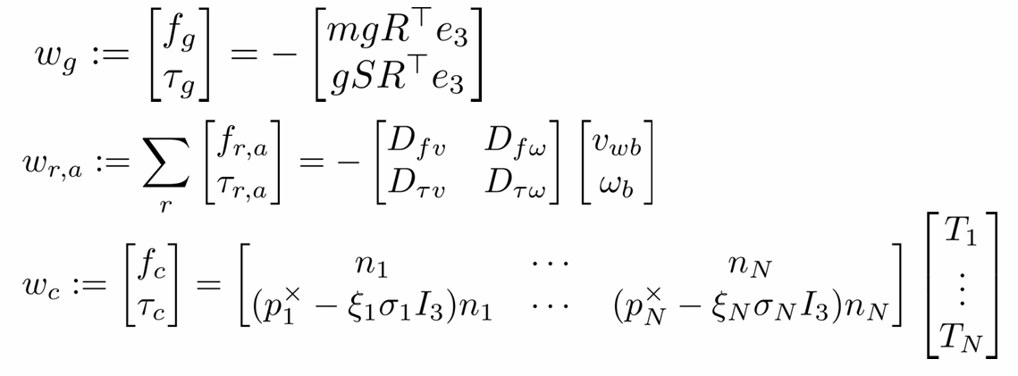
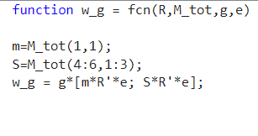
UAV MODEL

Slide 5
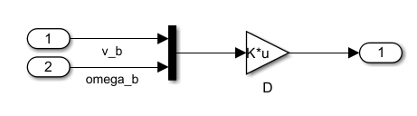
UAV MODEL

Slide 6
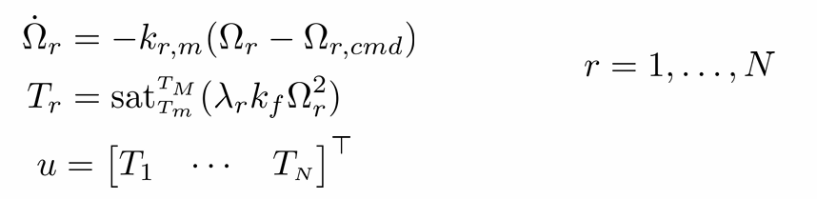
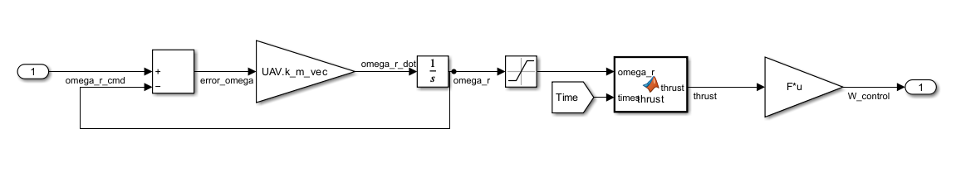
UAV MODEL

Slide 7
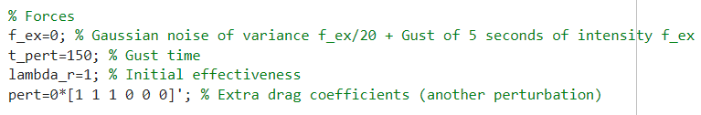
UAV MODEL

Slide 8
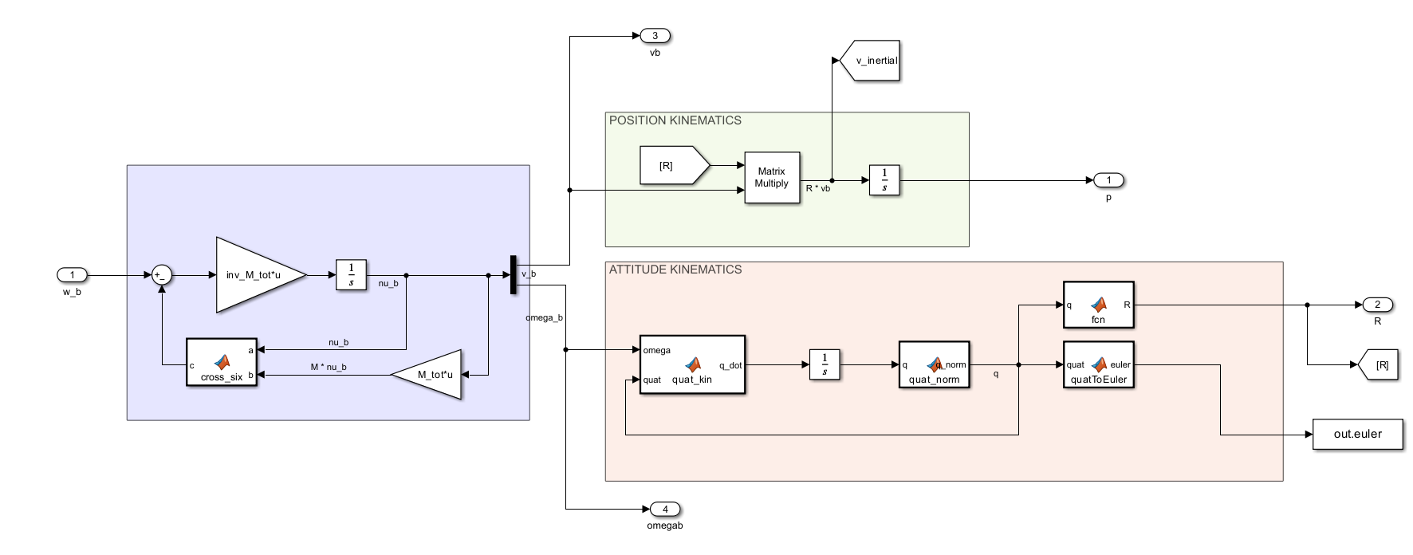
UAV MODEL

Slide 9
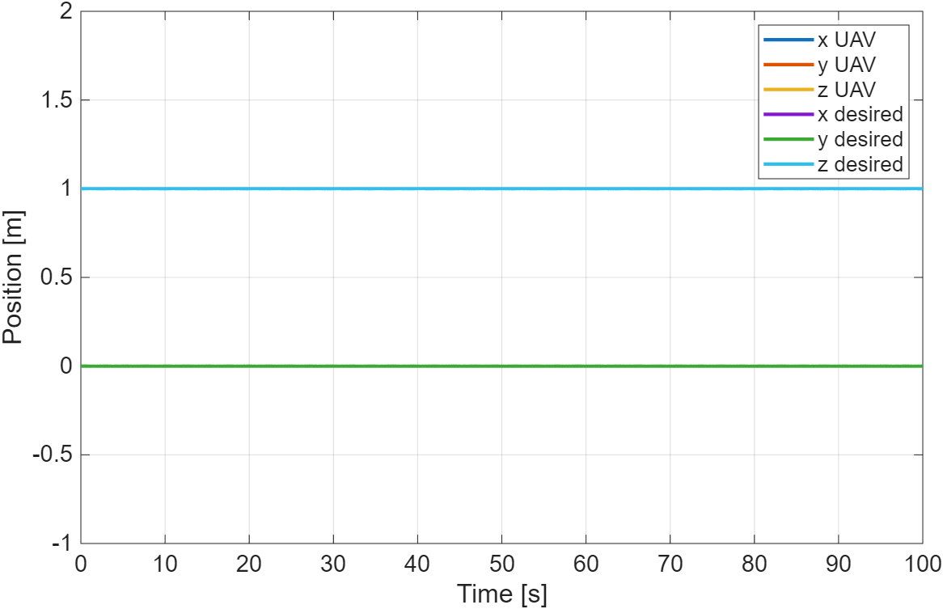
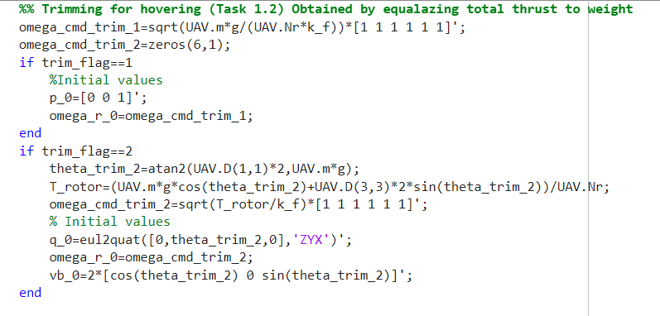
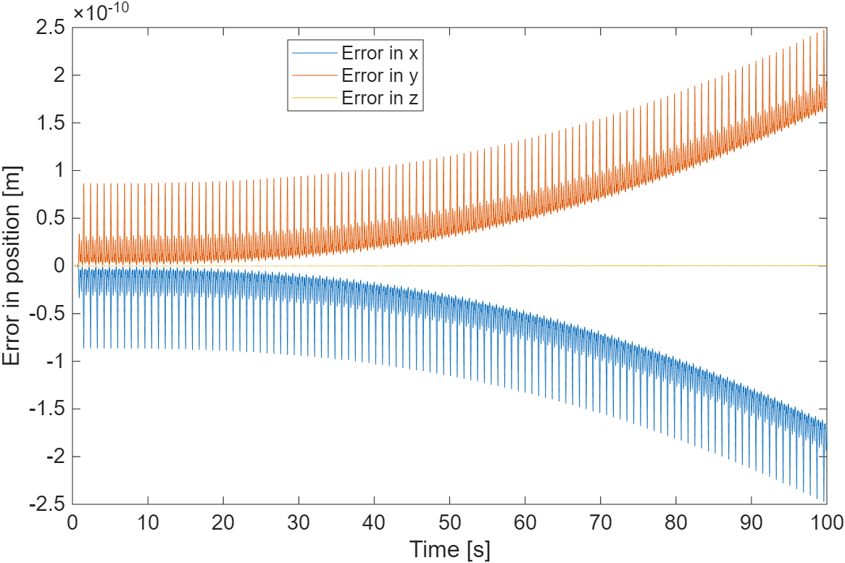
TRIMMING
Trim the UAV at p_{inertial} = [0 0 1]^{T} m

Slide 10

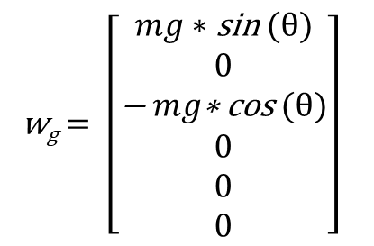
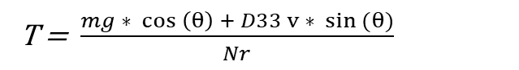
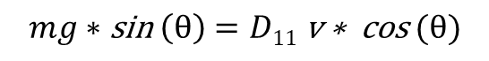
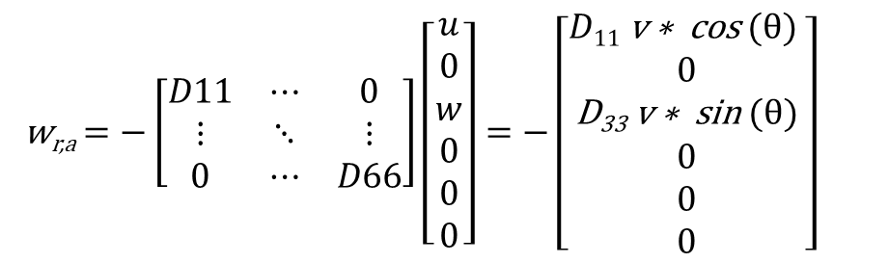
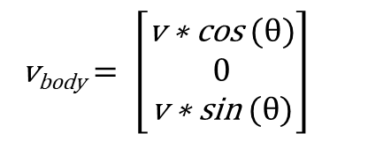
TRIMMING
Trim the UAV at v_{inertial} = [2 0 0]^{T} m/s
0
0
w_{g}$= \left[\begin{aligned}mg∗\text{sin} (θ) \\ 0 \\ \text{−} mg\text{∗ }\text{cos} (θ) \\ 0 \\ 0 \\ 0\end{aligned}\right]$
w_{r,a}$=−\left[\begin{matrix}D11 & ⋯ & 0 \\ ⋮ & ⋱ & ⋮ \\ 0 & ⋯ & D66\end{matrix}\right]\left[\begin{aligned}u \\ 0 \\ w \\ 0 \\ 0 \\ 0\end{aligned}\right]=−\left[\begin{aligned}D11 \text{v} \text{∗ }\text{cos} (θ) \\ 0 \\ \text{D}\text{33} \text{v} \text{∗ }\text{sin} (θ) \\ 0 \\ 0 \\ 0\end{aligned}\right]$
v_{body}$= \left[\begin{aligned}\text{v} \text{∗ }\text{cos} (θ) \\ 0 \\ \text{v} \text{∗ }\text{sin} (θ)\end{aligned}\right]$
$$mg∗\text{sin} \left(θ\right)=D11 \text{v} \text{∗ }\text{cos} (θ)$$
$$θ≅0.53°$$
T = $\frac{mg ∗ cos \left(θ\right) + D33 v ∗ sin (θ)}{Nr}$

Slide 11
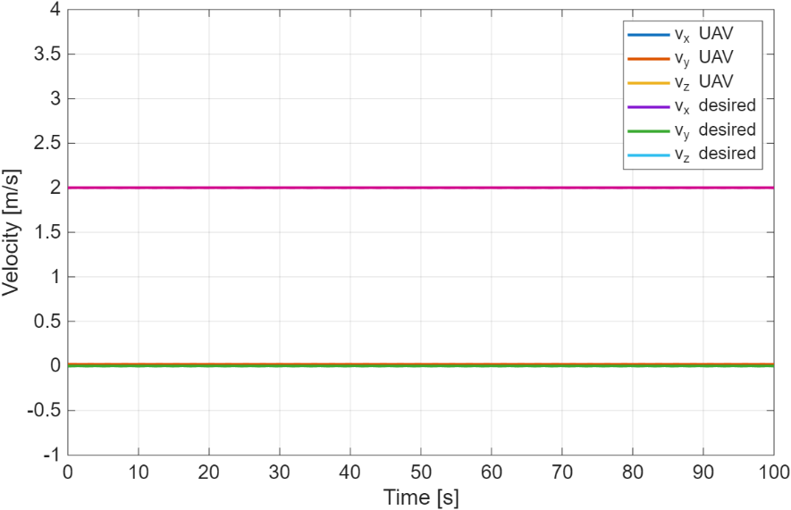
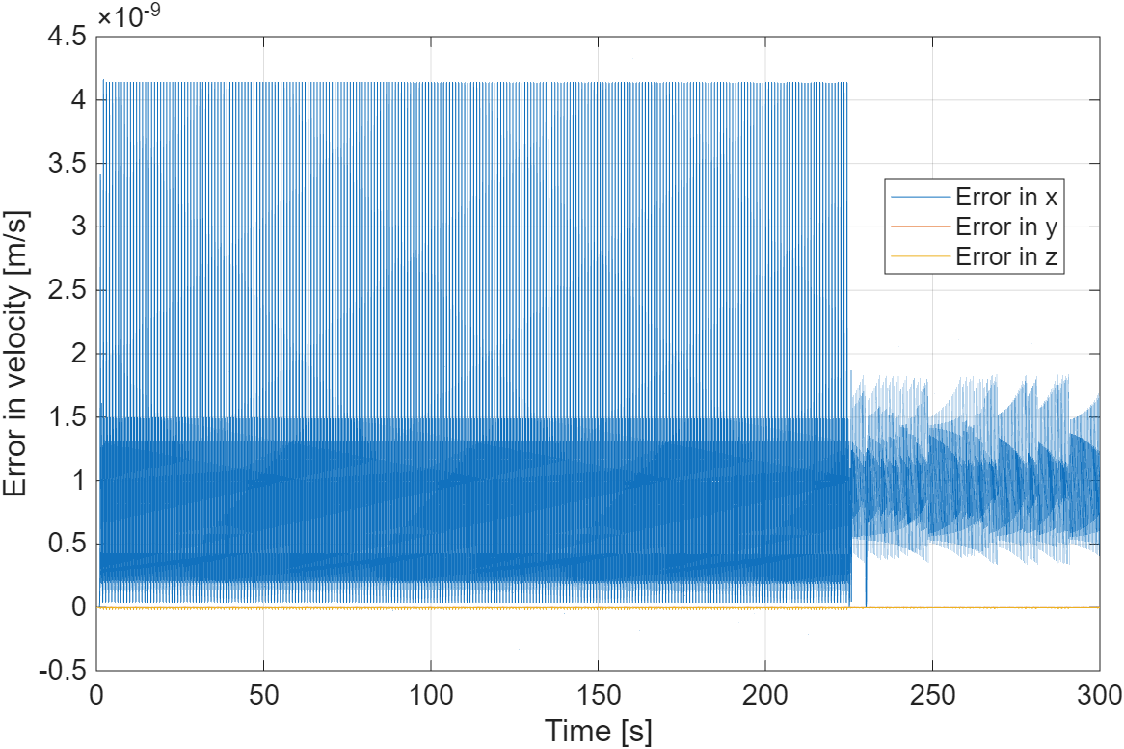
TRIMMING
Trim the UAV at v_{inertial} = [2 0 0]^{T} m/s

Slide 12
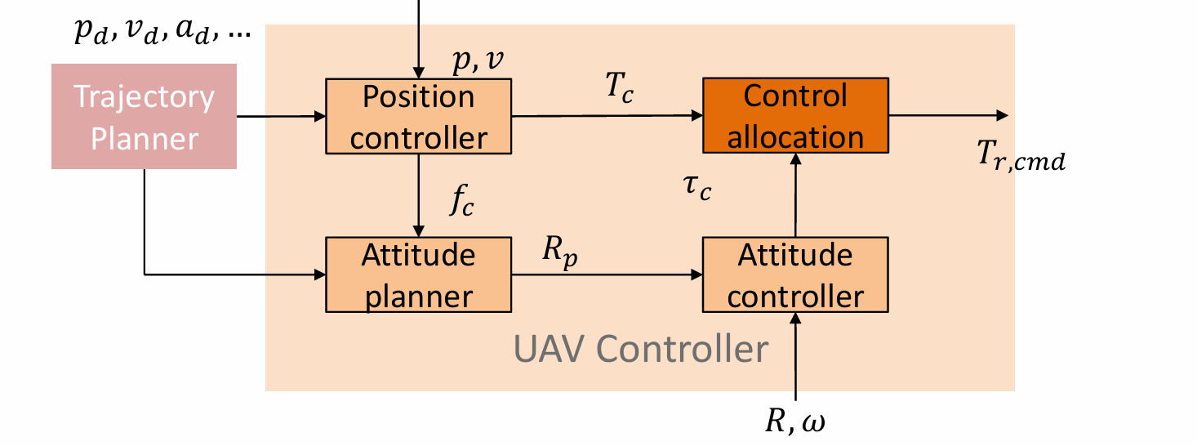
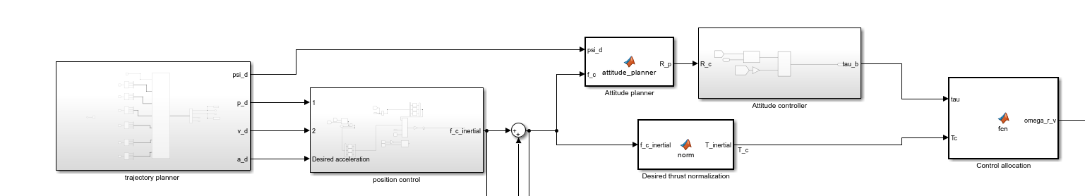
BASELINE CONTROLLER

Slide 13
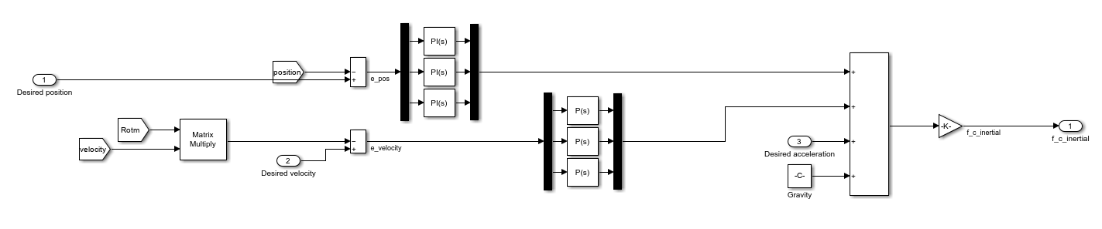
POSITION CONTROLLER

Slide 14
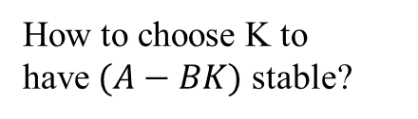
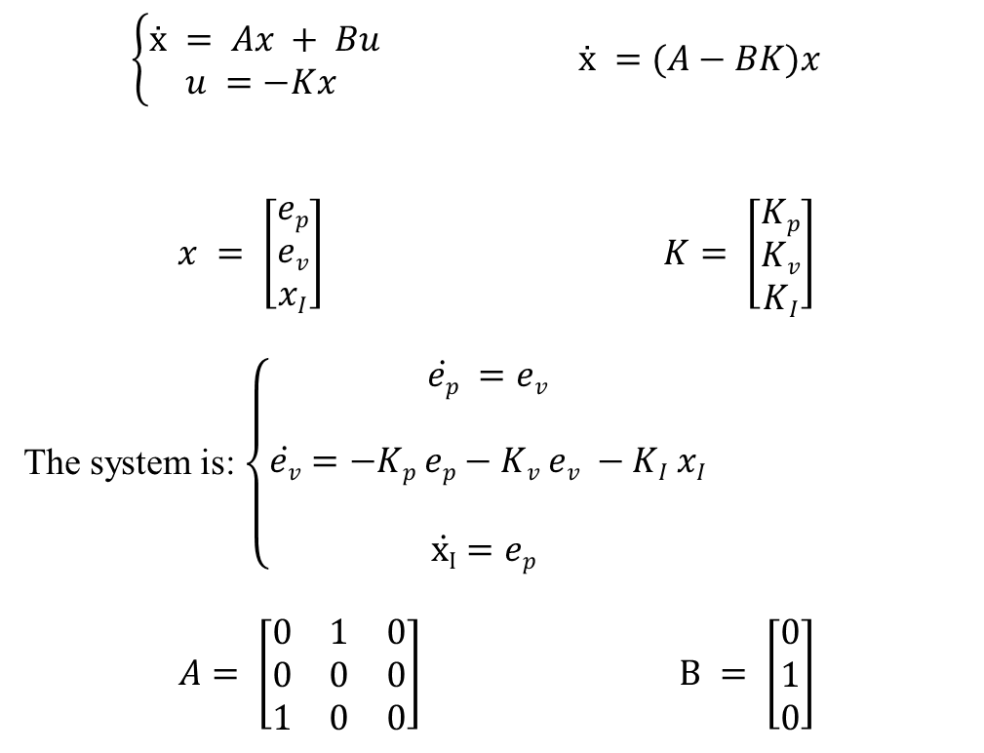
POSITION CONTROLLER: EIGENVALUE ASSIGNMENTS
$\left\{\begin{aligned}ẋ = Ax + Bu \\ u =−Kx \end{aligned}\right.$ $ẋ =(A−BK)x$
$$x = \left[\begin{aligned}ep \\ ev \\ xI\end{aligned}\right] K= \left[\begin{aligned}Kp \\ Kv \\ KI\end{aligned}\right]$$
The system is: $\left\{\begin{aligned}\dot{ep} =ev \\ \\ \dot{ev}=−Kp ep−Kv ev −KI xI \\ \\ \dot{xI}=ep \end{aligned}\right.$
$$A= \left[\begin{matrix}0 & 1 & 0 \\ 0 & 0 & 0 \\ 1 & 0 & 0\end{matrix}\right] B = \left[\begin{matrix}0 \\ 1 \\ 0\end{matrix}\right]$$
How to choose K to have$(A−BK)$ stable?

Slide 15
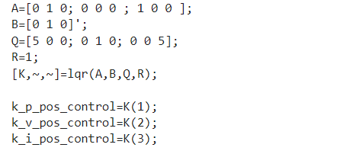
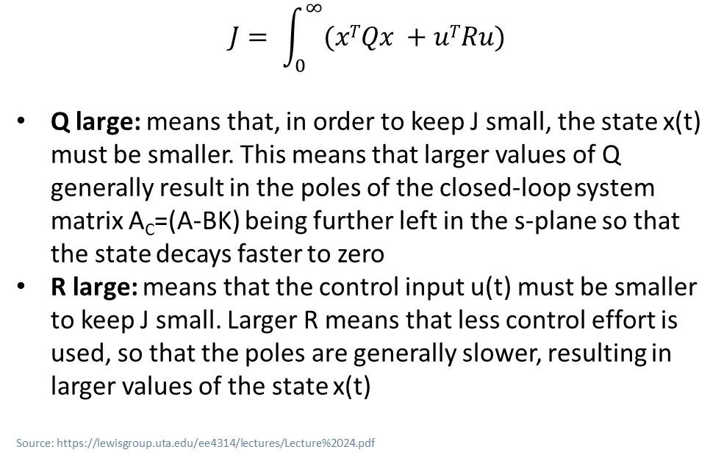
POSITION CONTROLLER: LQR
$$J= \int_{0}^{∞}{(xTQx +uTRu)}$$
Q large: means that, in order to keep J small, the state x(t) must be smaller. This means that larger values of Q generally result in the poles of the closed-loop system matrix A_{C}=(A-BK) being further left in the s-plane so that the state decays faster to zero
R large: means that the control input u(t) must be smaller to keep J small. Larger R means that less control effort is used, so that the poles are generally slower, resulting in larger values of the state x(t)
Source: https://lewisgroup.uta.edu/ee4314/lectures/Lecture%2024.pdf

Slide 16
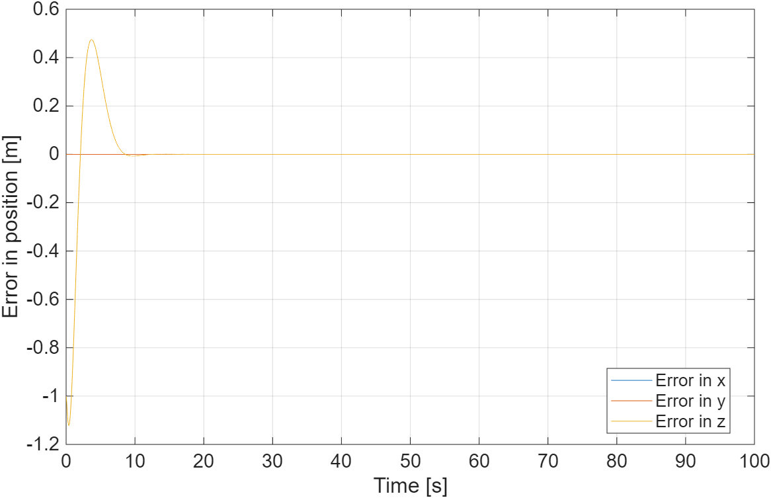
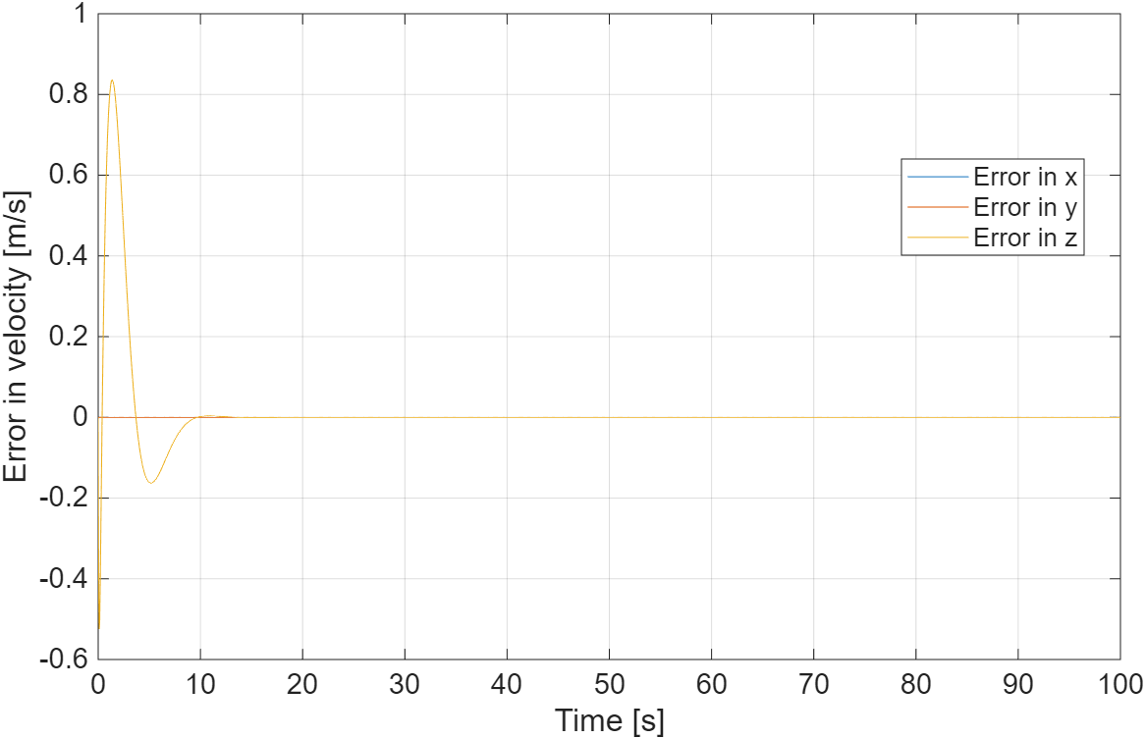
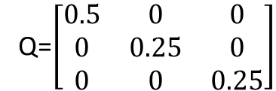
POSITION CONTROLLER: LQR
First attempt:
Q=$\left[\begin{matrix}0.5 & 0 & 0 \\ 0 & 0.25 & 0 \\ 0 & 0 & 0.25\end{matrix}\right]$
K_{P} = 1.52 K_{V}= 1.81 K_{I}= 0.50
Position overshoot: 50%
Settling time: 15 s
No saturation

Slide 17
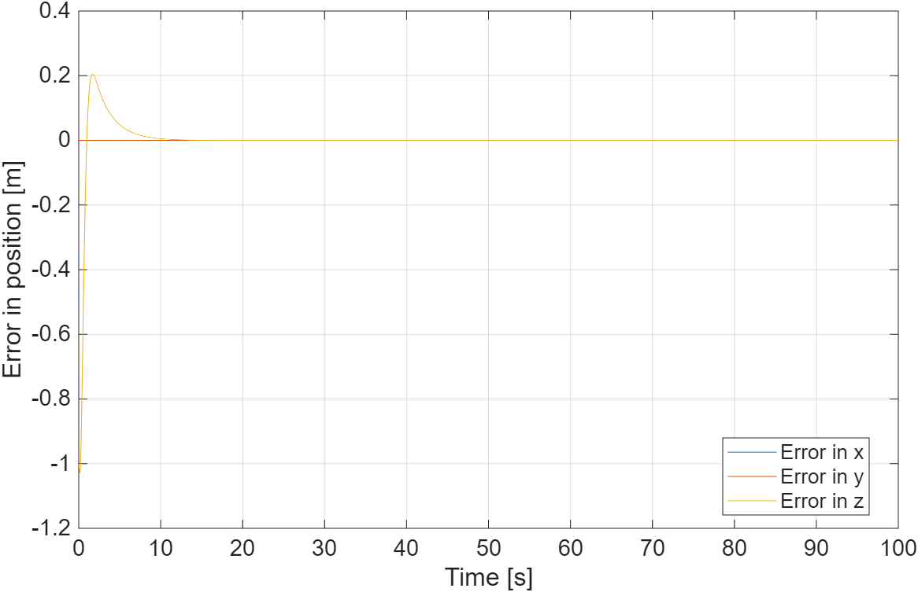
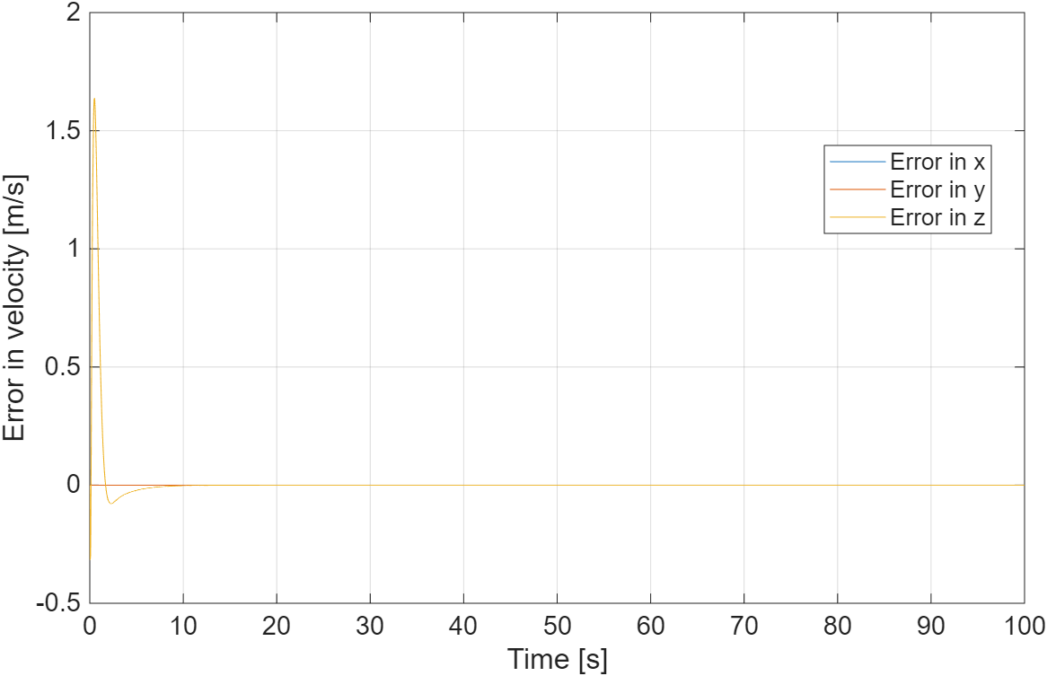
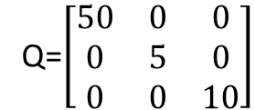
POSITION CONTROLLER: LQR
Second attempt:
Q=$\left[\begin{matrix}50 & 0 & 0 \\ 0 & 5 & 0 \\ 0 & 0 & 10\end{matrix}\right]$
K_{P} = 8.99 K_{V}= 4.79 K_{I}= 3.16
Position overshoot: 20%
Settling time: 10 s
Saturation

Slide 18
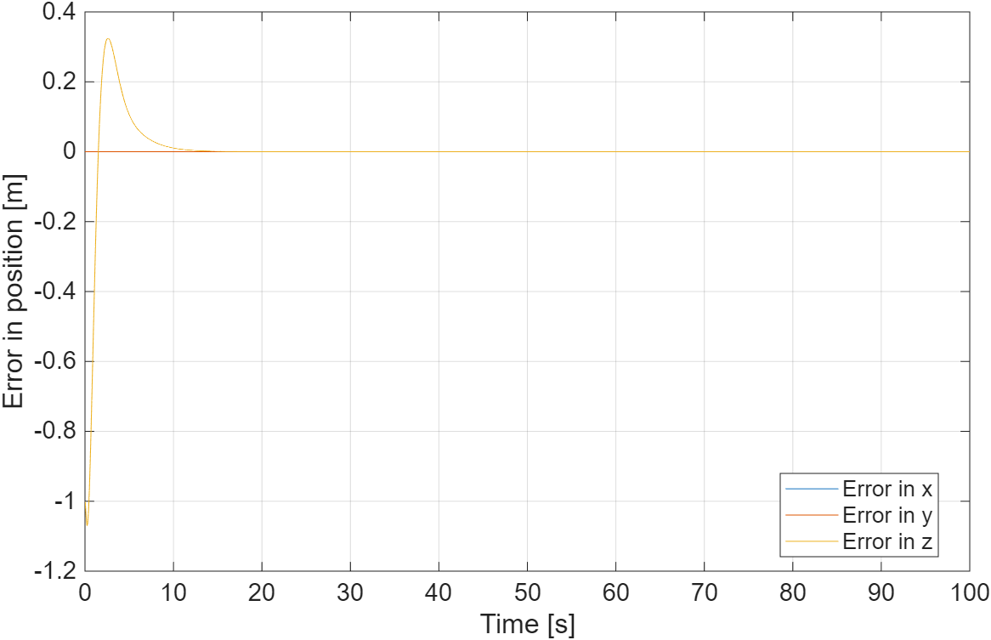

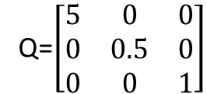
POSITION CONTROLLER: LQR
Third attempt:
Q=$\left[\begin{matrix}5 & 0 & 0 \\ 0 & 0.5 & 0 \\ 0 & 0 & 1\end{matrix}\right]$
K_{P} = 3.20 K_{V}= 2.63 K_{I}= 1.00
Position overshoot: 30%
Settling time: 11 s
No saturation

Slide 19
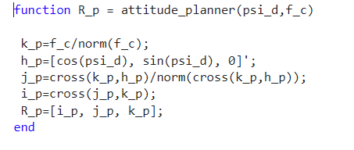
ATTITUDE PLANNER

Slide 20
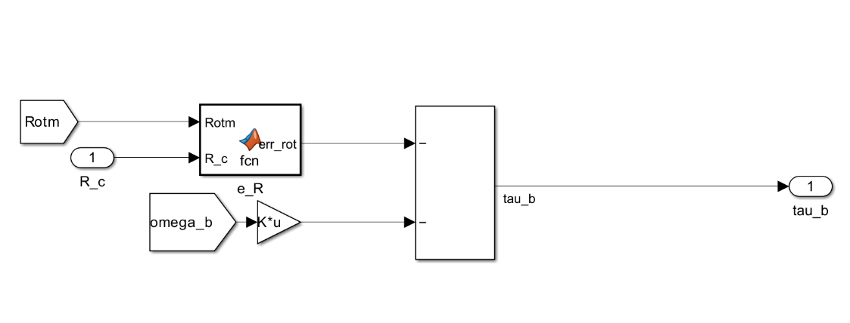
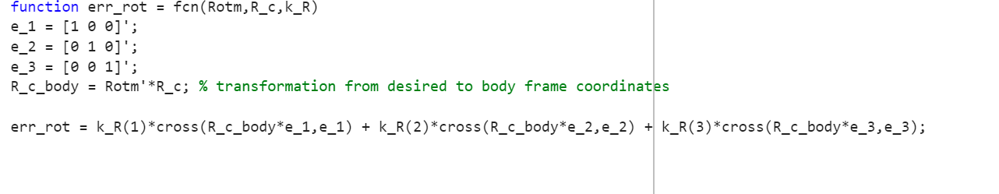
ATTITUDE CONTROLLER

Slide 21
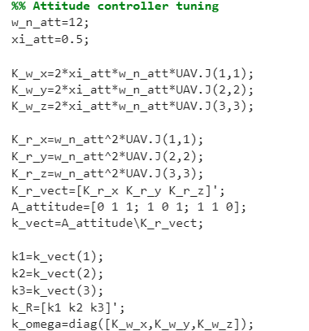
ATTITUDE CONTROLLER

Slide 22
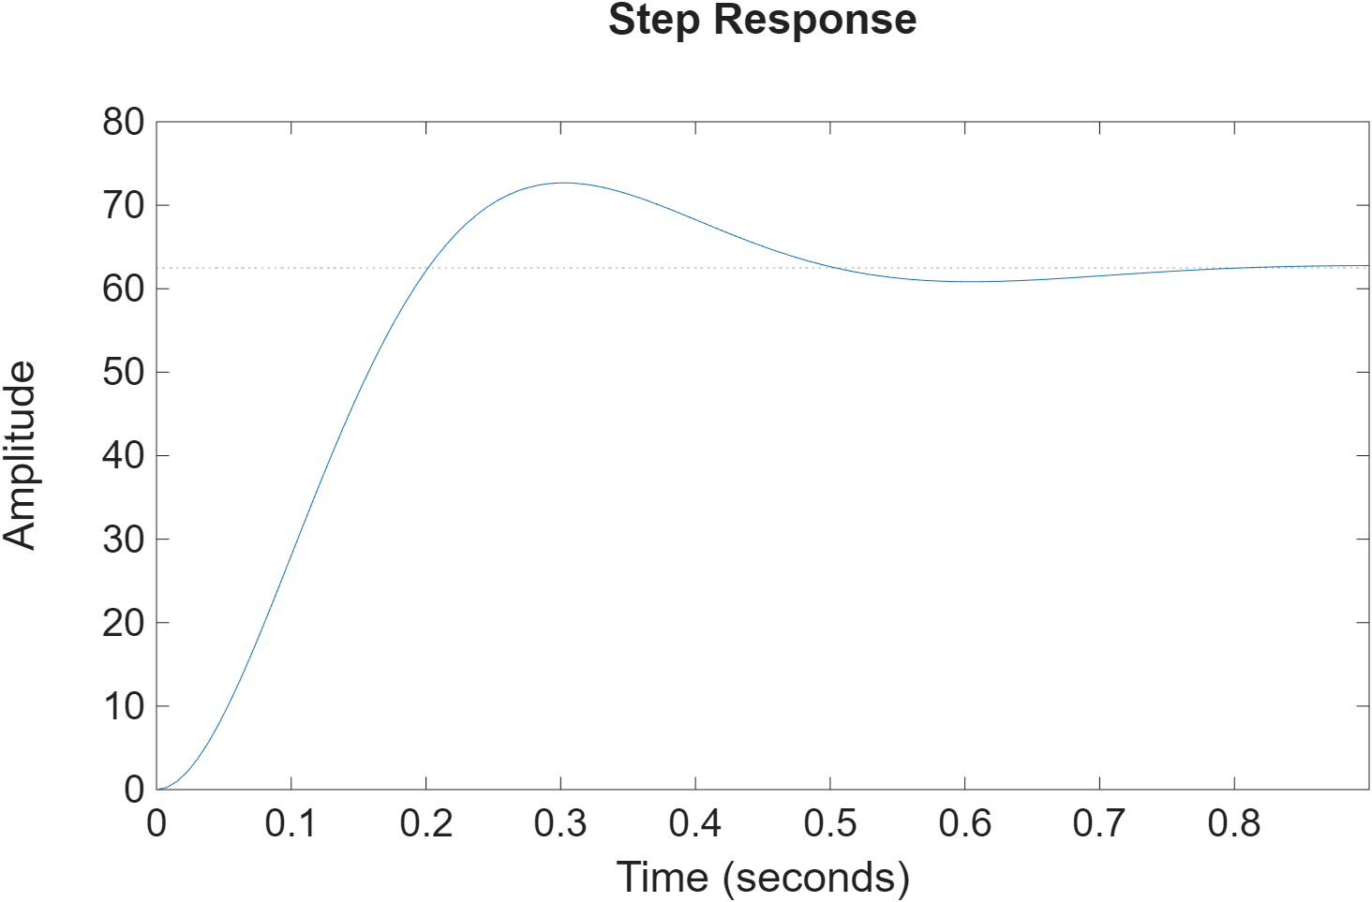
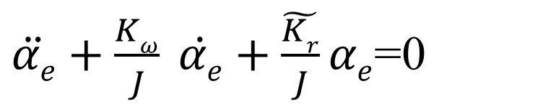
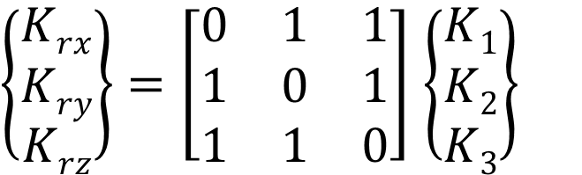
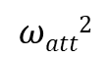
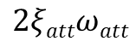
ATTITUDE CONTROLLER
$$J\dot{ωb}+ωbXJωb≅−Kωωb−\tilde{Kr}αe$$
0
$\ddot{αe}+\frac{Kω}{J} \dot{αe}+\frac{\tilde{Kr}}{J}αe$=0
$$2ξattωatt$$
$$ωatt2$$
$\left\{\begin{matrix}Krx \\ Kry \\ Krz\end{matrix}\right\}=\left[\begin{matrix}0 & 1 & 1 \\ 1 & 0 & 1 \\ 1 & 1 & 0\end{matrix}\right]$ $\left\{\begin{matrix}K1 \\ K2 \\ K3\end{matrix}\right\}$

Slide 23
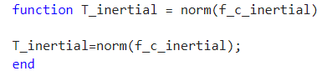
DESIRED THRUST NORMALIZATION

Slide 24
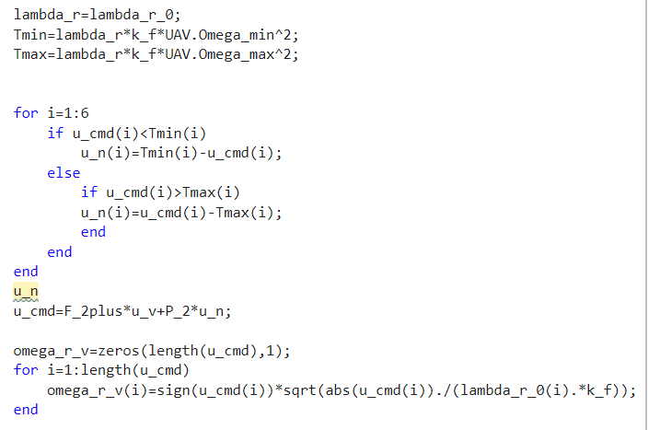
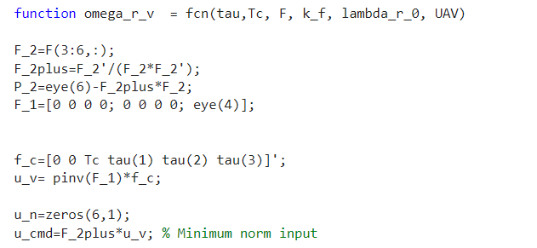
CONTROL ALLOCATION

Slide 25
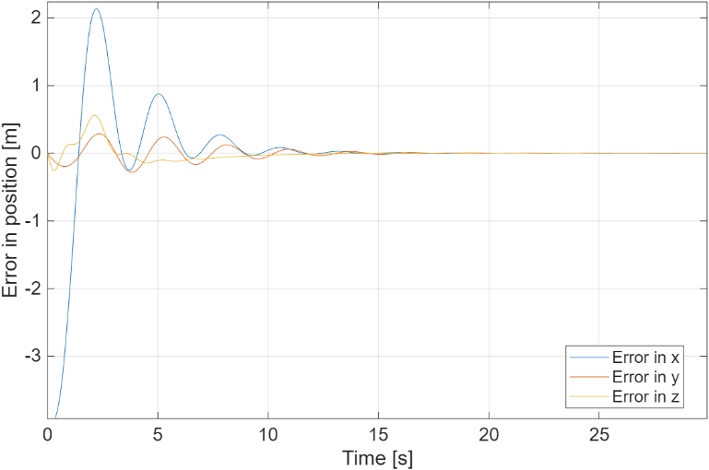



TEST THE BASELINE CONTROLLER
Spiral maneuver ($ω$_{t}=0.1 rad/s w_{t}=1 m/s r=4 m):

Slide 26

REDUCTION OF THE PROPELLERS’ EFFECTIVENESS
Adding a reduction of effectiveness of 40% in 500 sec:
The controller compensates the reduction of $λ…$

Slide 27

ADAPTIVE AUGMENTATION
Package properties:

Slide 28


ADAPTIVE AUGMENTATION
We verified the behavior of the baseline control system in the following scenario:
Presence of package with 0.4 kg of mass
Spiral with Gaussian noise f_{ext}= $\frac{1}{20}$N
5 seconds gust disturbance of intensity f_{ext}= [1 1 1] N at time t_{pert}=225 s

Slide 29



ADAPTIVE AUGMENTATION

Slide 30

ADAPTIVE AUGMENTATION

Slide 31


ADAPTIVE AUGMENTATION
The goal is to make the prediction error converge to zero asymptotically:

Slide 32


ADAPTIVE AUGMENTATION
Considering the following uncertain UAV dynamics for position control augmentation:

Slide 33



ADAPTIVE AUGMENTATION

Slide 34


ADAPTIVE AUGMENTATION
N.B. we introduced an e-modification:

Slide 35

ADAPTIVE AUGMENTATION

Slide 36

ADAPTIVE AUGMENTATION
“Increasing the adaptation gain can arbitrarily reduce the tracking error, even during transients. However, large adaptive gains lead to high-gain feedback, high-frequency oscillations in the control signal, and reduced tolerance to delays. Since no systematic guidelines exist for selecting these gains, tuning MRAC controllers typically relies on simulations or empirical trial-and-error, making effective gain selection a major practical challenge.”
Source: https://engineering.purdue.edu/~zak/ECE675__2022/L1_adaptive_control.pdf
L=1:
$Γa$=0.001*I_{6x6}:
Fast error convergence
Numerically stable
Good transient
Smooth control effort
Sufficiently fast convergence
Uniform adaptation for all parameters
Avoid over-aggressive adaptation
Larger values of $Γ_{a}$ may cause:
noisy parameter estimates
oscillatory control responses

Slide 37


ADAPTIVE AUGMENTATION
We verified the behavior of the baseline + PBMRAC control system in the following scenario:
Presence of package with 0.4 kg of mass
Spiral with Gaussian noise f_{ext}= $\frac{1}{20}$N
5 seconds gust disturbance of intensity f_{ext}= [1 1 1] N at time t_{pert}=225 s
Reduction of propellers’ effectiveness of 40% in 500 sec:

Slide 38


ADAPTIVE AUGMENTATION

Slide 39


ADAPTIVE AUGMENTATION

Slide 40



ADAPTIVE AUGMENTATION

Slide 41

ADAPTIVE AUGMENTATION
Without adaptive:
With adaptive:

Slide 42




ADAPTIVE AUGMENTATION
Without package:
With 0.2 Kg package:
With 0.4 Kg package:

Slide 43
UAV CONTROLLER

Slide 44


TEST IN DELIVERY SCENARIO

Slide 45

TEST IN DELIVERY SCENARIO

Slide 46


TEST IN DELIVERY SCENARIO

Slide 47


TEST IN DELIVERY SCENARIO

Slide 48


TEST IN DELIVERY SCENARIO

Slide 49


TEST IN DELIVERY SCENARIO

Slide 50


TEST IN DELIVERY SCENARIO

Slide 51


CONCLUSIONS
We verified the behavior of the baseline + PBMRAC control system in the following urban scenario:
Presence of package with 0.4 kg of mass
Gaussian noise f_{ext}= $\frac{1}{20}$N
5 seconds gust disturbance of intensity f_{ext}= [1 1 1] N at time t_{pert}=50 s
Reduction of propellers’ effectiveness of 40% in 500 sec

Slide 52
CONCLUSIONS
Obtaining the following results:
The UAV successfully covered 70 m in 61 s
Peak velocity: 3.5 m/s
Maximum tracking error: 0.8 m
Control signals remained smooth and free of saturation
The adaptive augmentation ensured robustness to: • Payload mass variations up to 0.6 kg • Package dimensions up to l_box = 0.8 m • Gust disturbances up to 4 N per axis

